Slide 1
THE i-DELIVER SYSTEM
GROUP 18

Slide 2
TEAM MEMBERS
Supervisor: Nguyễn Trọng Tài
Nguyễn Thanh Tùng
Lê Phúc Lữ
Nguyễn Tấn Đức
Đào Bảo Long

Slide 3
OUTLINE
Scenario problems
Advantages & disadvantages of current scenario
Propose solution
Demonstration
Advantages & disadvantages of solution
Future plan
Technology & development environment

Slide 4
SCENARIO PROBLEMS
The demand of goods delivery using coach beside travellers transport
The traditional delivery process has many disadvantages

Slide 5
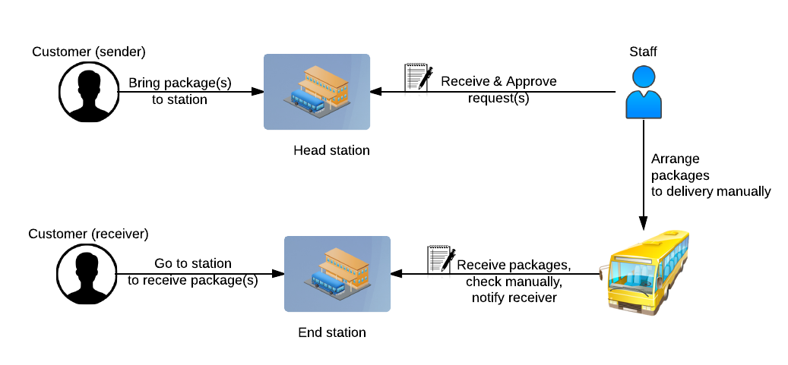
The traditional delivery process

Slide 6


ADVANTAGES DISADVANTAGES
No need to setup
No training time
Paper documents
No statistics report
Internet connection unnecessary
Ineffective manual work

Slide 7
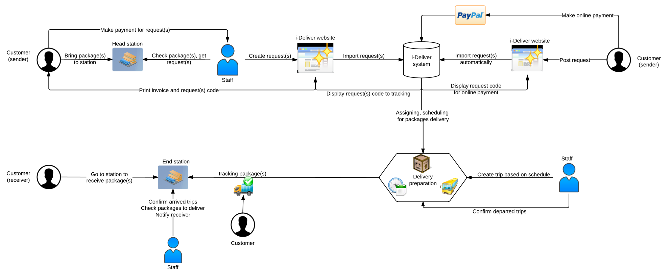
PROPOSE SCENARIO
Notice: This system does not optimize coach scheduling for trip and cost of delivery process.

Slide 8
FEATURES
Online payment
Auto assigning
Easy tracking
Post request online

Slide 9






TECHNOLOGY & DEVELOPMENT ENVIRONMENT

Slide 11
ADVANTAGES OF NEW SYSTEM
Request for goods delivery easily
Simple ways to manage and tracking requests/packages
Online payment every time everywhere
Small installation cost
Easy deployment
Less hand work, less paper document
Statistics on performance, revenue
Customers can rate and comment about station’s service

Slide 12
DISADVANTAGES OF NEW SYSTEM
Each station must have a computer with internet connection
Each station must have a staff with basic computer skills to import request manually

Slide 13



FUTURE PLAN
Develop and optimize algorithms for coach scheduling and reduce cost of delivery process
Develop mobile apps on another platform: iOS, Windows Phone, Android

Slide 14
Thanks for listening Q&A

